Slide 1
Programming JAVA {
Hiveed.java
Multithreading;
/* Here is where your journey for your dream begins */
}
JAVA Programming

Slide 2
Hiveed.java
What is Multithreading :
The process of executing two or more task at same time time and maximum utilization of CPU.
Life Cycle of Thread :
New State
Runnable State
Blocked State
Waiting State
Timed Waiting State
Terminated State
JAVA Programming

Slide 3
Hiveed.java
New state :
When a thread lies in the new state.
Its code is yet to be run and hasn’t started to execute.
Runnable State :
In this state, a thread might actually be running or it might be ready to run at any instant of time.
Blocked: State :
In this state, a thread might actually be running or it might be ready to run at any instant of time.
JAVA Programming

Slide 4
Hiveed.java
Waiting state :
The thread will be in waiting state when it calls wait() method or join() method. It will move to the runnable state when other thread will notify or that thread will be terminated.
Timed Waiting::
A thread lies in a timed waiting state when it calls a method with a time-out parameter.
A thread lies in this state until the timeout is completed or until a notification is received.
Terminated State :
This happens when the code of the thread has been entirely executed by the program.
JAVA Programming

Slide 5
Hiveed.java
Multithreading
Thread
Runnable
JAVA Programming

Slide 6
Hiveed.java
What is the difference beetween thread and runnable :
Theread is a class
And Runnable is interface.
It is the main difference between Thread and interface.
To implement multithreading concept.
We must extends the Thread class ( or ) implements the Runnable Class
JAVA Programming

Slide 7
Hiveed.java
Thread Class & Runnable interface :
The class should extends the thread.
And the class contain the run method.
To execute the thread we use “ start() ” statement to call the run method.
We can set the priority to thread.
And there is lot of method present in the Thread and runnable Class.
JAVA Programming

Slide 8
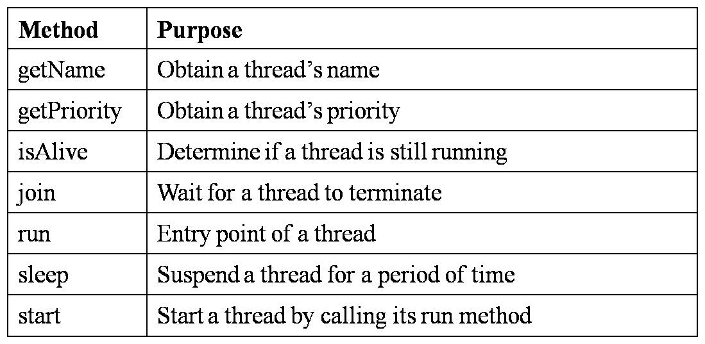
Hiveed.java
Some Important methods :
JAVA Programming

Slide 9
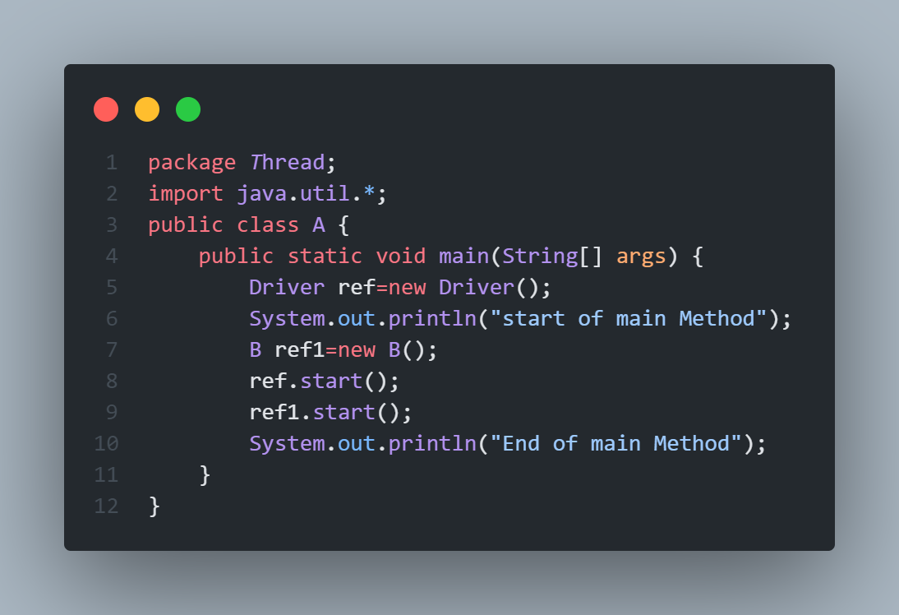
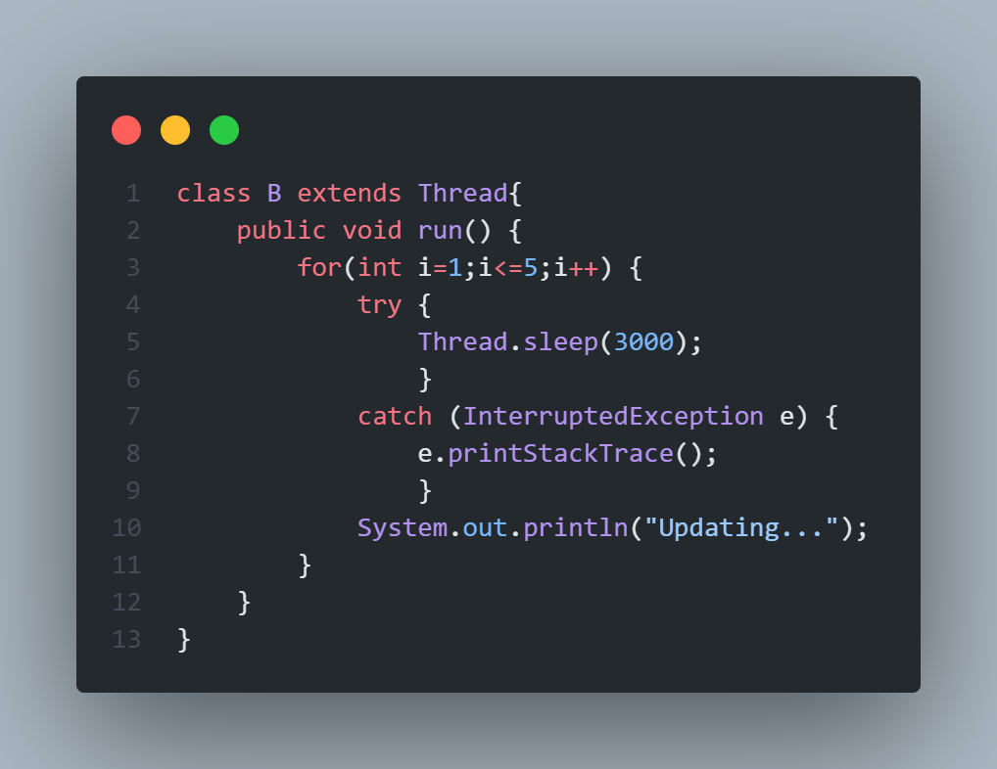
Hiveed.java
Using Thread Class :
JAVA Programming

Slide 10
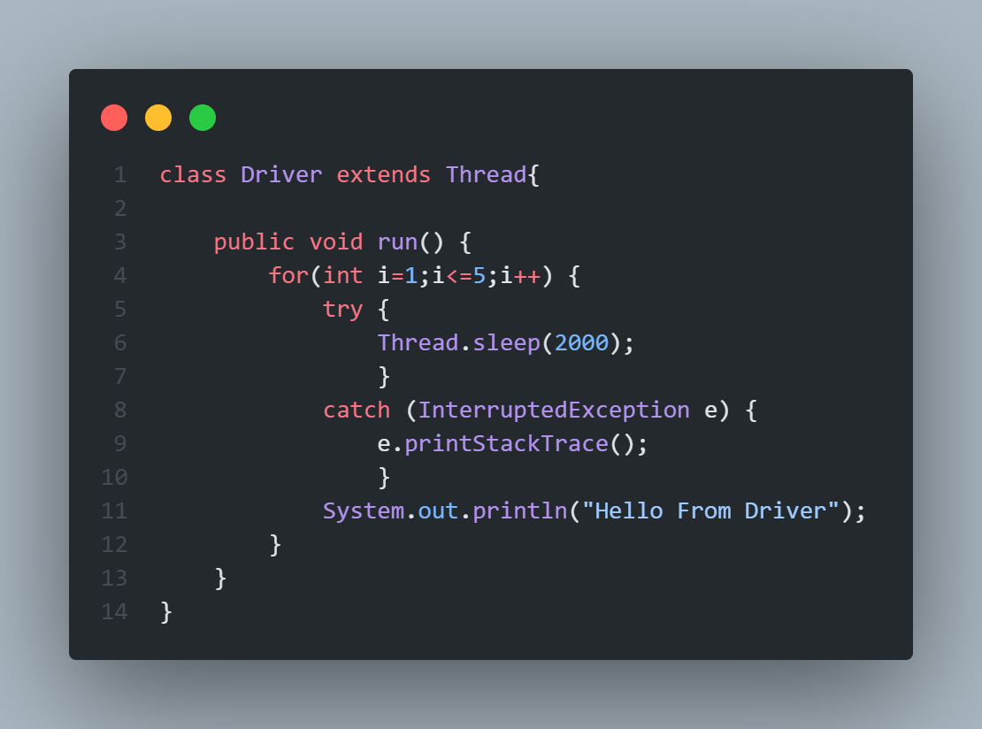
Hiveed.java
JAVA Programming

Slide 11
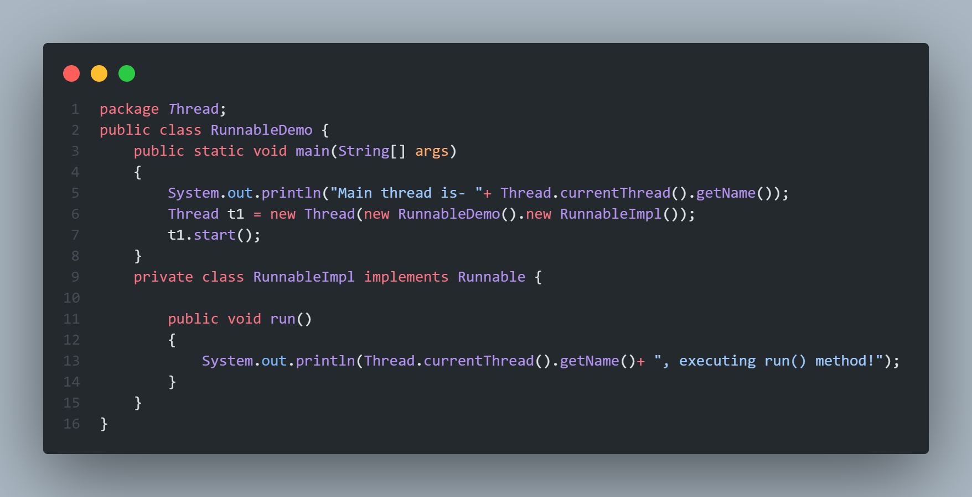
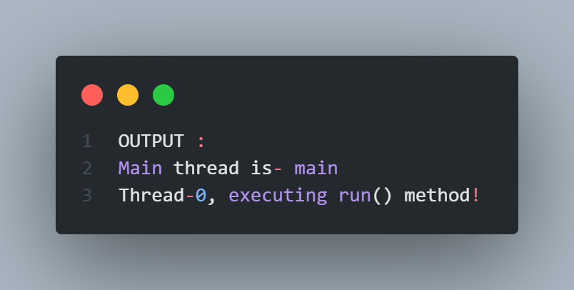
Hiveed.java
Using Runnable interface :
JAVA Programming

